Slide 1
Movies by Women Directors

Slide 2
The question
How do movies by women directors compare with movies by men?
What are the budgets like?
Revenues?
What % in a given year are made by women?
etc…

Slide 3
The method
I used:
The Movie Database (TMDb) API, for budget, revenue, cast, and popularity data for top movies
The Genderize API, to make guesses about the gender of movie directors based on first names

Slide 4
The data
I pulled data for 3000 movies, and cleaned out movies without budgets, revenue, gender, or release years
I was left with 2004 movies to analyze

Slide 5
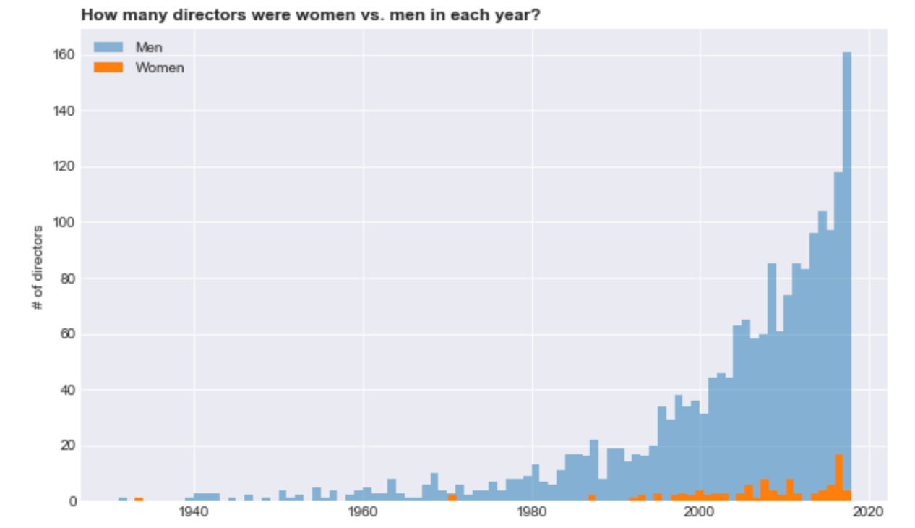
Turns out there aren’t many movies by women directors
Only 4.94% of movies had a woman director

Slide 6
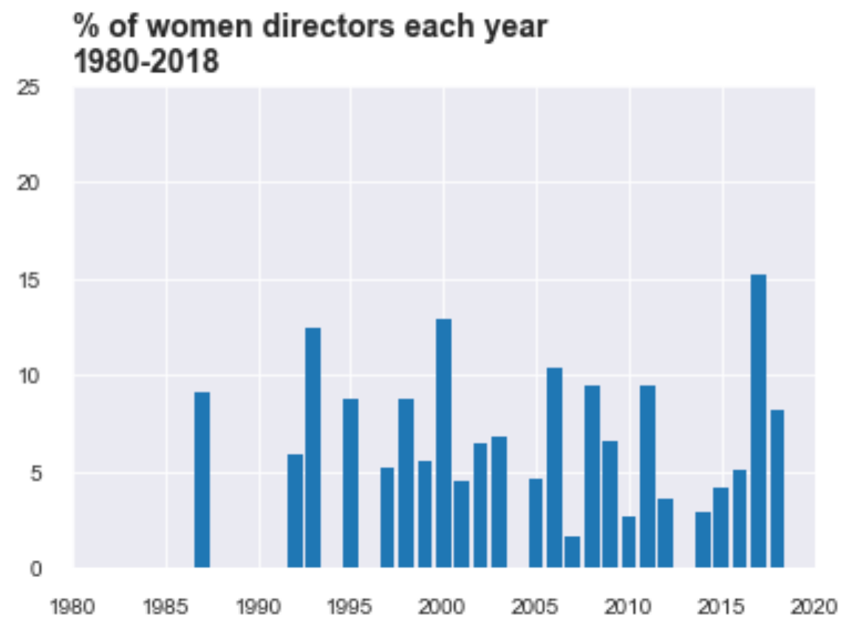
Since the mid ’80s…
At most 15% of directors in a year were women

Slide 7
Budgets for women directors are lower
Average budget for movies with women directors is $39.37 million – $14.73 million less than men.
The disparity is worse for the top quartile – where women directors have a budget of $28.5 million less than men.

Slide 8
ROI for women directors is lower
Average revenue for movies with women directors is $131.07 million – $60.73 million less than men.
ROI is a little lower for women directors than for men - $3.33 of revenue for every $1 of budget invested, vs. $3.55 for a man.
Advertising budgets, anyone?

Slide 9
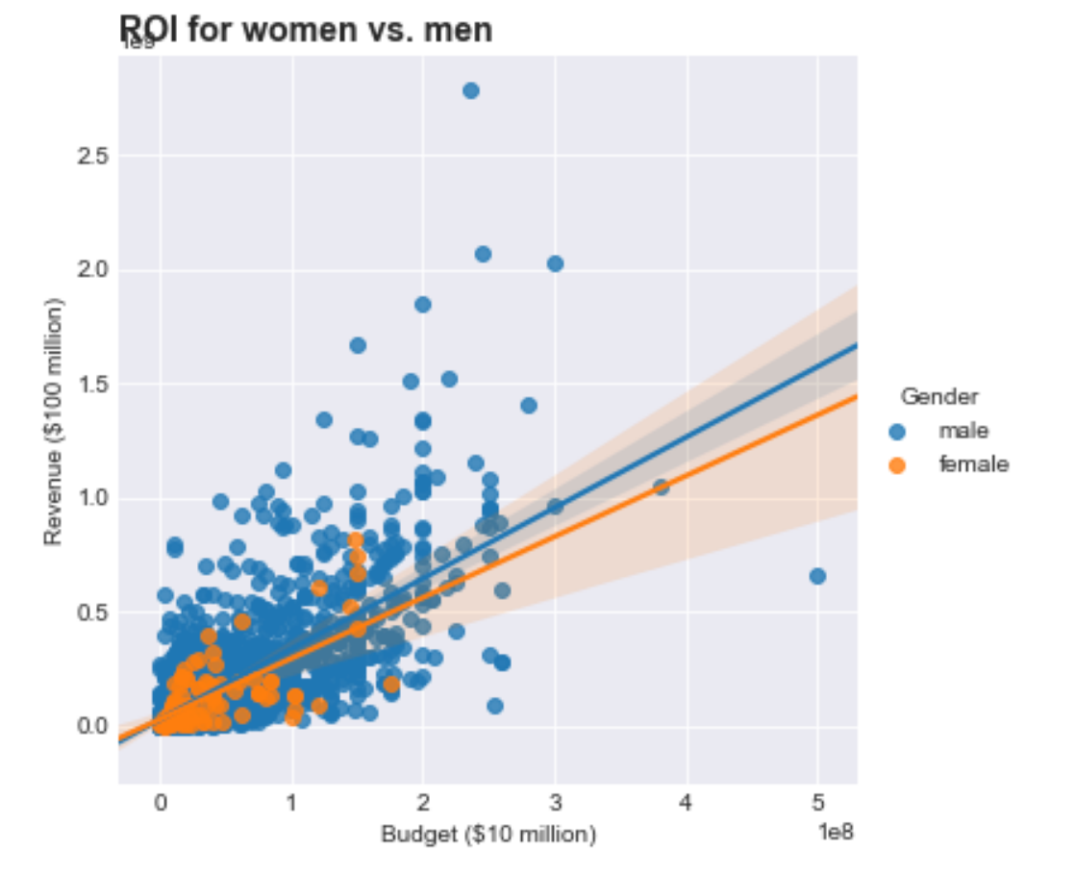
ROI for women directors

Slide 10
Movies by women directors are slightly less popular than by men
On average, movies by women directors are just slightly less popular than movies by men in the TMDb community
Average community rating of 6.62 for women vs. 6.65 for men.

Slide 11
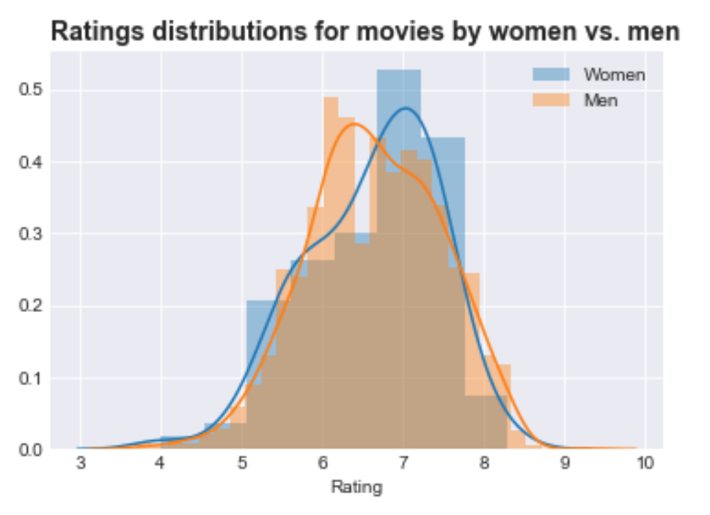
Popularity of movies by women directors

Slide 12
Does spending more on a movie make it more popular?
The answer: sort of. TMDb popularity rank tends to be higher for big-budget movies.
Movies by women directors are slightly less popular, even at higher budgets, though.

Slide 13
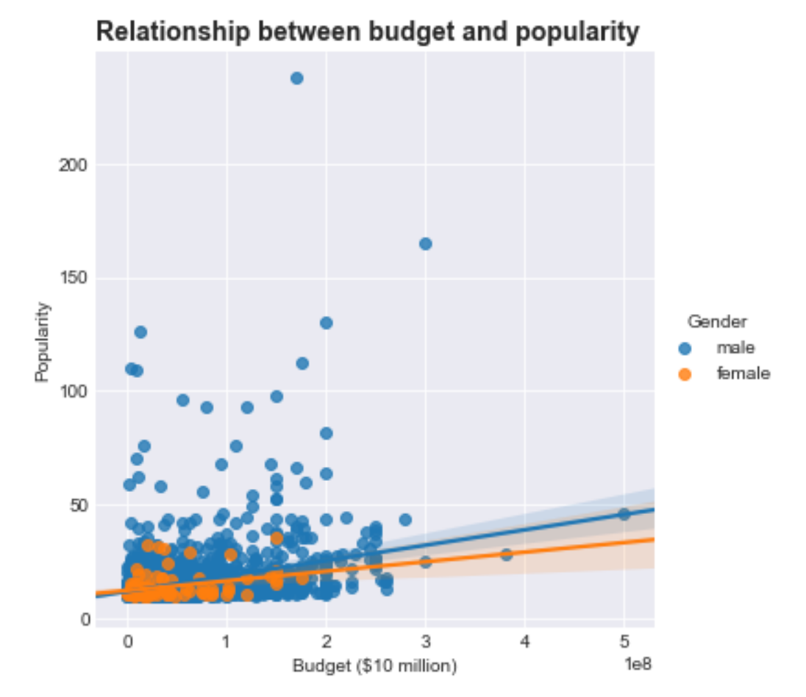
Does spending more on a movie make it more popular?

Slide 14
Directions for further research
Investigate why movies by women directors have lower ROI than for men.
Find data on movies' advertising budgets, social media conversation, media coverage, etc
Causal hypothesis: that women directors get less support and less serious coverage, and so make less money per dollar of filmmaking budget
Scrape Metacritic/Rotten Tomatoes rating data.
How does it correlate with TMDb ratings? Is there a gender disparity? Is the distribution skewed similarly to the TMDb ratings distribution?

